Slide 1





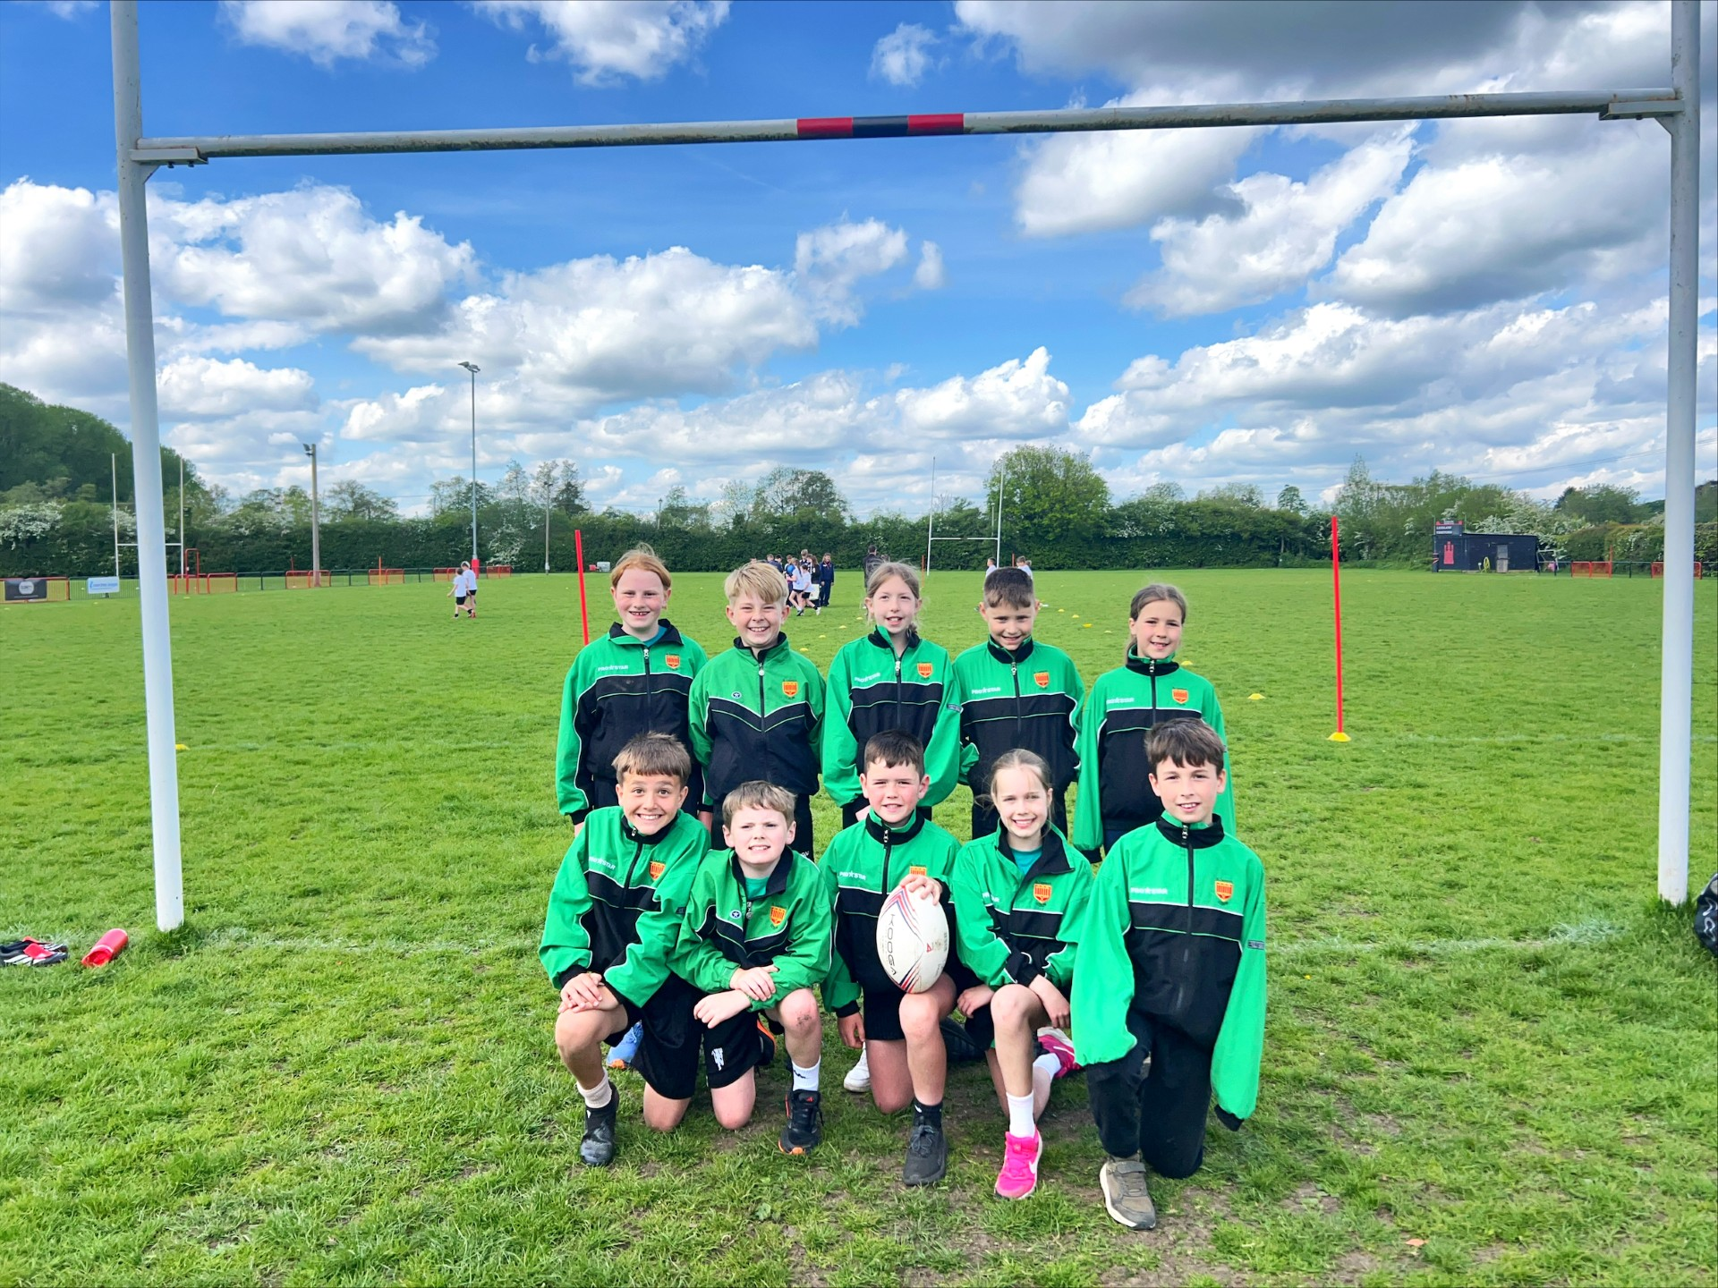


Jockey Field, Ludlow. Shropshire. SY8 1TP
Telephone: 01584 872766 email: admin@st-laurenceprimary.com
www.st-laurenceprimary.com
Friday 8th May 2026
Please could we remind parents to telephone or email the school before 9am to notify us of any absence. admin@st-laurenceprimary.com 01584 872766. If we do not hear from you children will be marked as unauthorised.
Summer Term – Week 4
T1 Rugby tournament
Our children represented the school brilliantly at the Year 5/6 Rugby Tournament down at Ludlow Rugby club. They played with great confidence, determination, and teamwork. It was fantastic to see the children applying new skills they have been learning in T1 rugby and supporting one another in every match.
Although the team did not make it through to the finals, they should be extremely proud of their performance. Well done to all the players for their hard work and effort!
SPECIAL MENTIONS
Year 1
Harry
Erin
Year 4
Lexi
Ivar
Year 2
Hannah-Grace
Florence
Year 5
George
Clara
Year 3
Logan G
Dylan
Year 6
Harrison
Artem
Cake Sale Success
A huge thank you to all of our parents, carers, and families for your generous contributions and support for our cake sale held after school this week. Thanks to your kindness and enthusiasm, we are delighted to share that we raised an amazing £224.55 for the National Deaf Children’s Society.
We are incredibly grateful for all the donations, baking, and support that helped make the event such a success. Your contributions will help support deaf children, young people, and their families across the UK.
Thank you once again for supporting this important cause!
Courtesy Cup
This week’s courtesy cup winner goes to Lily E.J, she has been nominated for being very polite and kind when walking around school
Well done Lily!

Slide 2

Diary Dates
May
11th Year 6 SAT’s week
13th – Y4 Swimming
18th – Year 1 Castle Trip
20th – Y4 Swimming
25th May Half Term
June
16th – 18th Y6 London Trip
19th – Reception Class Fathers Day Picnic
25th – Y6 Hereford Cathedral Leavers Service
July
1st – Tear 5 Taster day @ Ludlow School
3rd – Summer Fete
7th – Y6 Induction Day @ Ludlow School
8th – Sports Day
9th – Year 1 & 2 School Trip
15th – Y6 Leavers Service 10.3am
15th – Y6 Production at Assembly Rooms

